Slide 1

CREDIT CARD WEEKLY STATUS REPORT

Slide 2
Project Objective
To develop a comprehensive credit card weekly dashboard that provide real-time insights into key performance metrics and trends, enabling stakeholders to monitor and analyze credit card operations effectively.

Slide 3
Project Insights-Week-53( 31st Dec)
WoW change:
Revenue increased by 28.8%.
Total transaction amount and count increased by % and %.
Customer count increased by xx%.

Slide 4
Project Insights-Week-53( 31st Dec)
Overall revenue is 57M
Total interest is 8M
Total transaction amount is 46M
Male customers are contributing more in revenue: 31M, female: 26M
Blue & Silver credit cards are contributing to 93% of overall transactions
TX, NY & CA are contributing to 68%
Overall activation rate is 57.5%
Overall delinquent rate is 6.06%

Slide 5
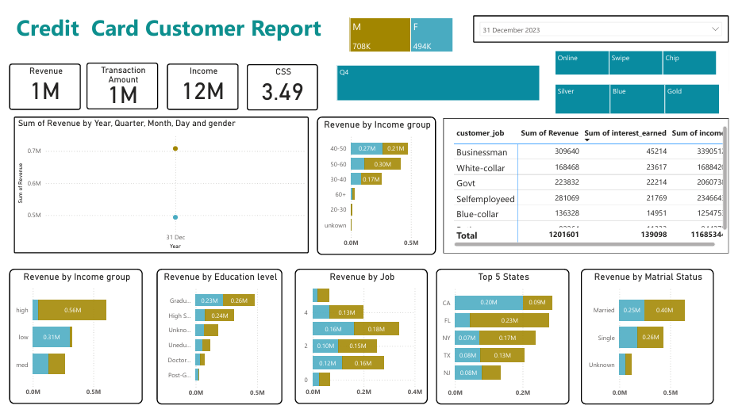

Slide 6
Conclusion
As we close out Week 53 and reflect on the year’s performance, the data presents a compelling story. With an overall revenue of $57M, driven significantly by male customers contributing $31M and female customers $26M, we see a strong market engagement across demographics. The blue and silver credit cards continue to dominate transactions, accounting for 93% of total activity, reinforcing their popularity.
These insights provide a solid foundation for refining strategies in the coming weeks and ensuring sustainable growth in the credit card market. Moving forward, optimizing customer engagement and improving delinquency management will be key priorities.

